Slide 1
Pension Management System
(Mini Project)
SRILATA SIVANI TAMMINENI

Slide 2
Abstract
Two types of users. Admin and User.
User is applicant.
Applicant is either active employee or retired employee.
Retired employee can withdraw amount from his pension account.
Active employee cannot withdraw amount from his pension account.

Slide 3
Requirements
Java JDK
Spring Boot framework
Maven tool
MySql
Postman
Docker

Slide 4
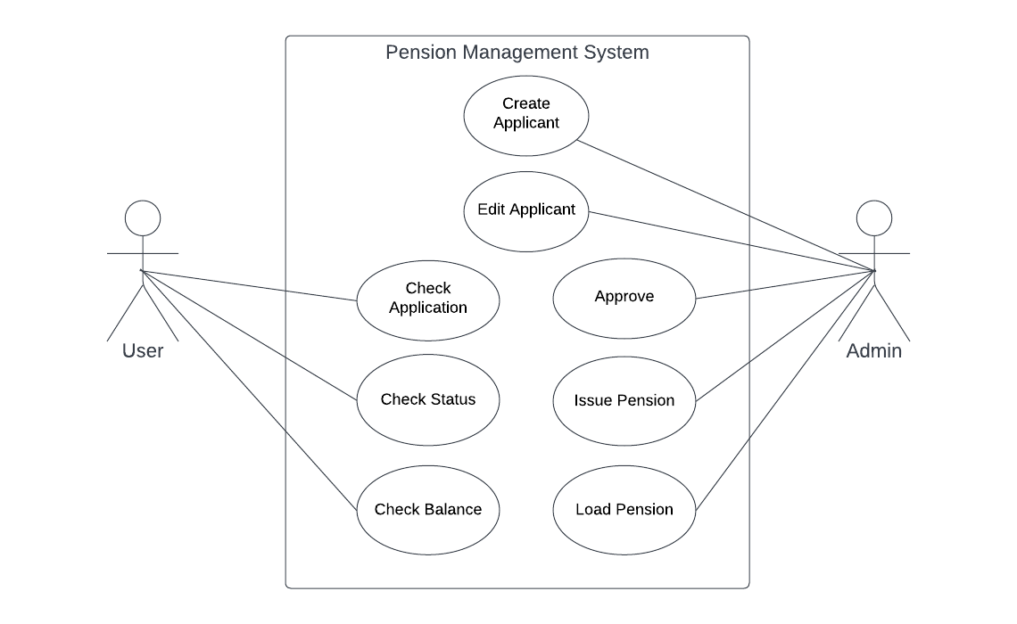
Use Case Diagram

Slide 5
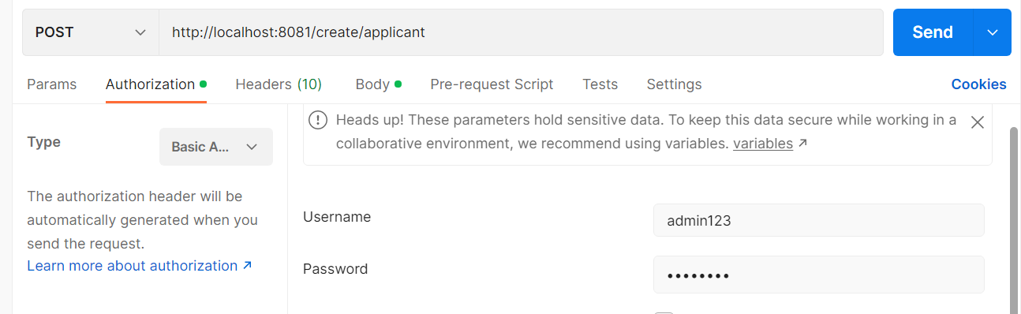
Application Demo

Slide 6
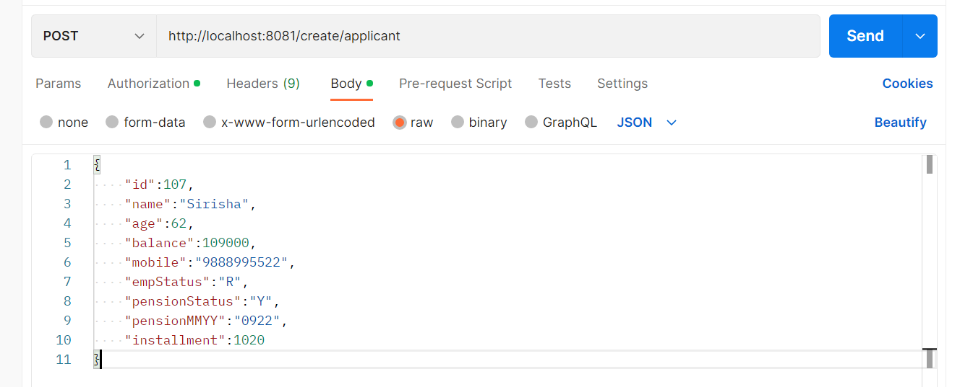
Create New Applicant

Slide 7
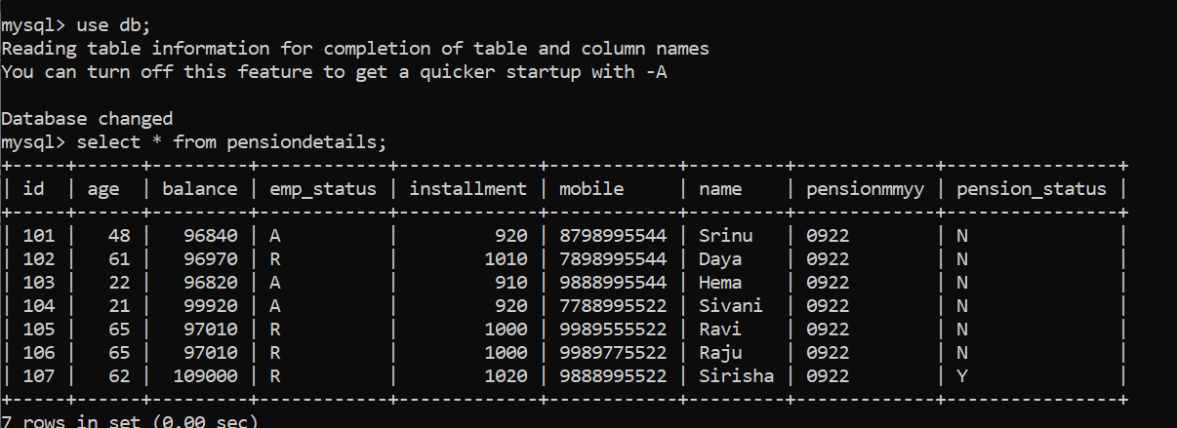
Checking MySql Database

Slide 8
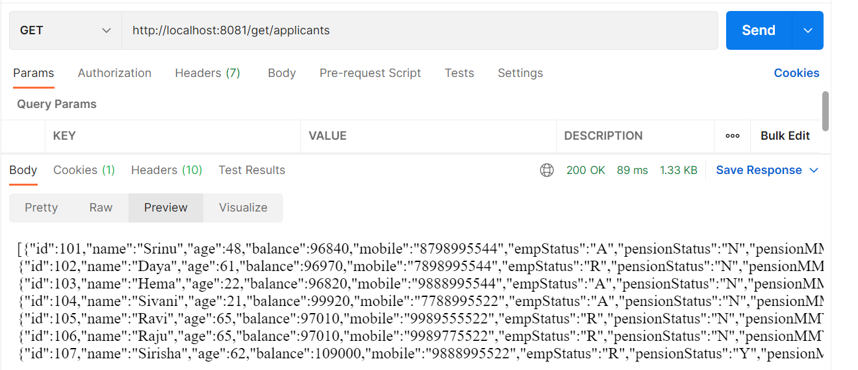
GetAllApplicants URL

Slide 9
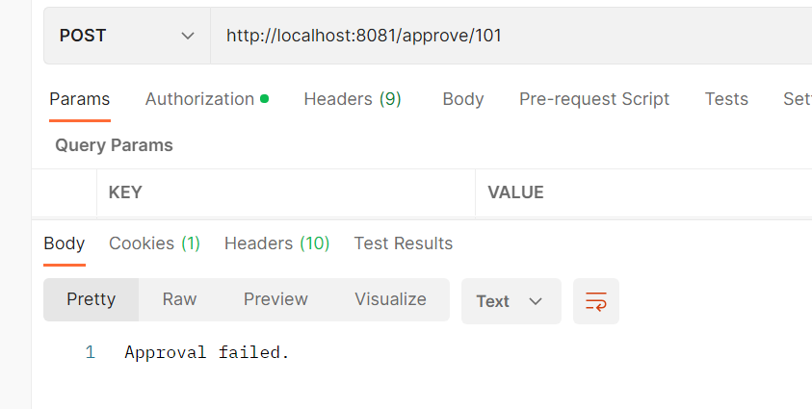
Approval by Admin (empStatus:A)

Slide 10
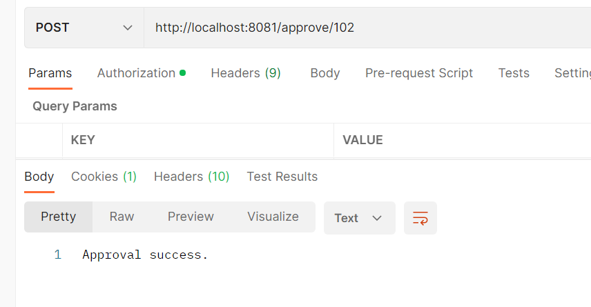
Approval by Admin (empStatus:R)

Slide 11
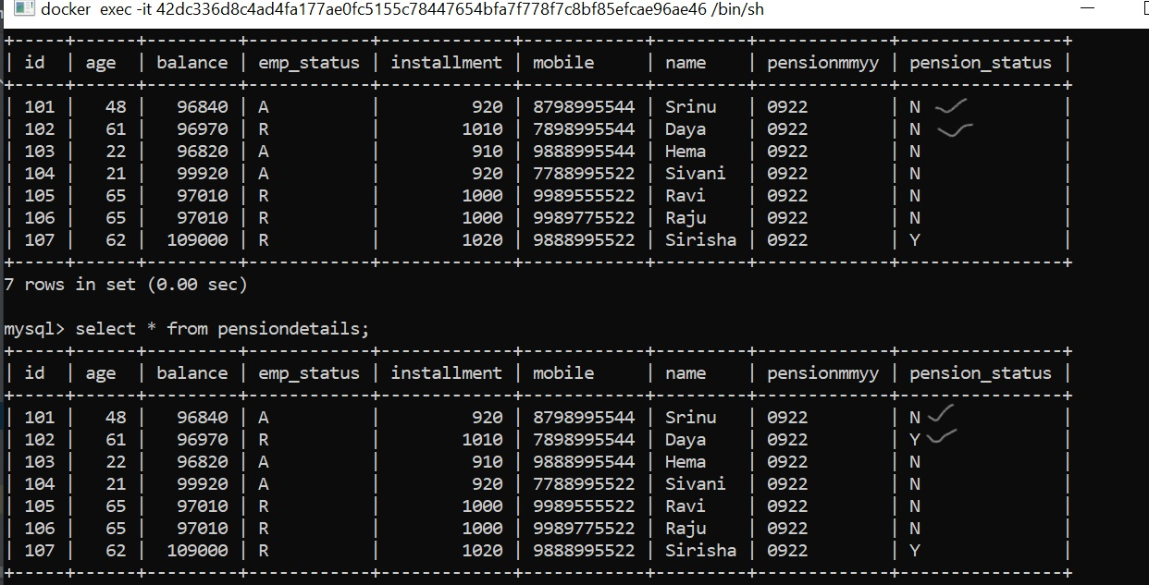
Checking the database

Slide 12
LoadPension
http://localhost:8081/loadPension
Bal = Bal + installment
empStatus must be “A” and pensionStatus must be “N”

Slide 13
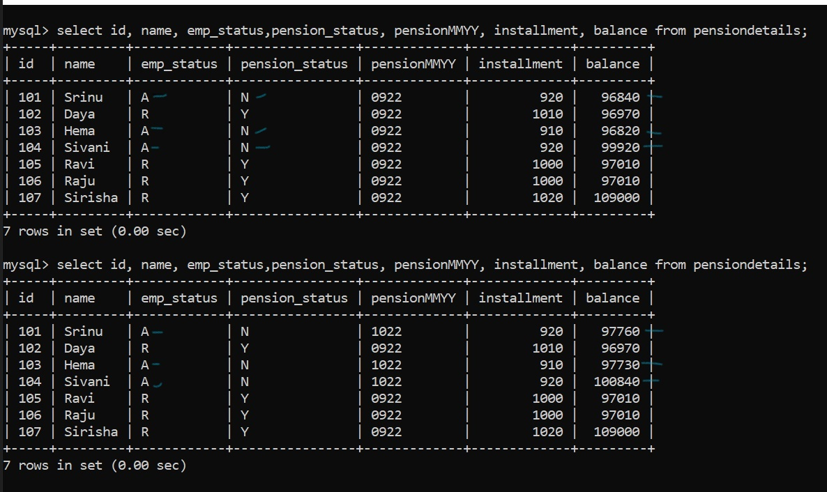

Slide 14
IssuePension
http://localhost:8081/issuePension
Bal = Bal - installment
empStatus must be “R” and pensionStatus must be “Y”

Slide 15
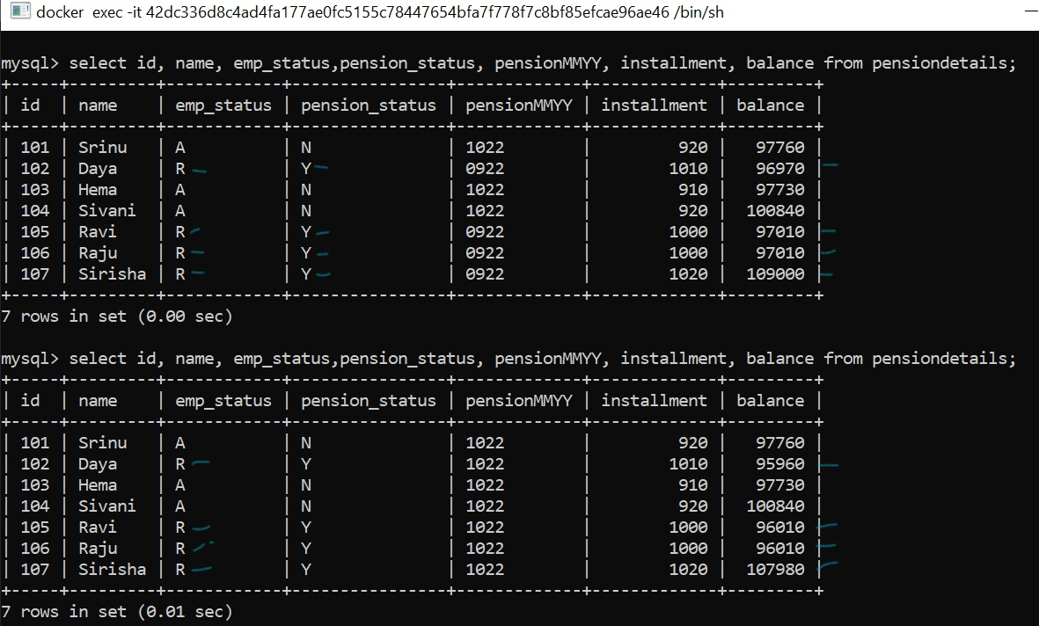

Slide 16
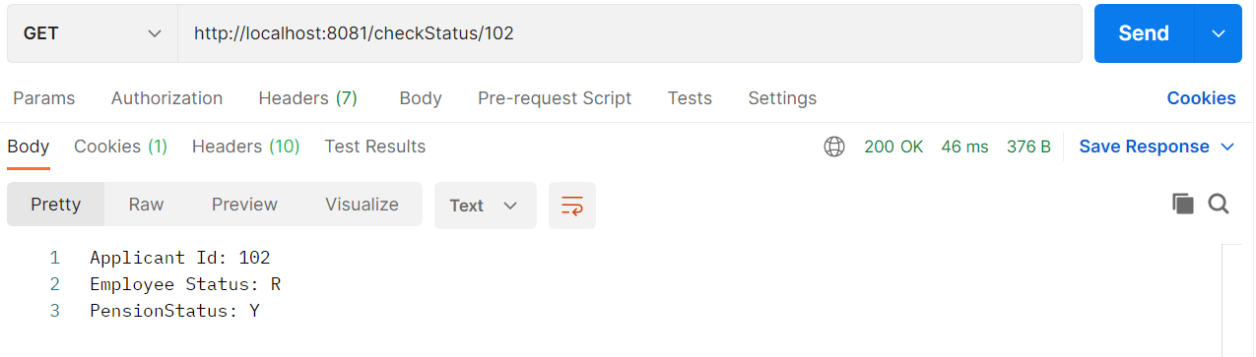
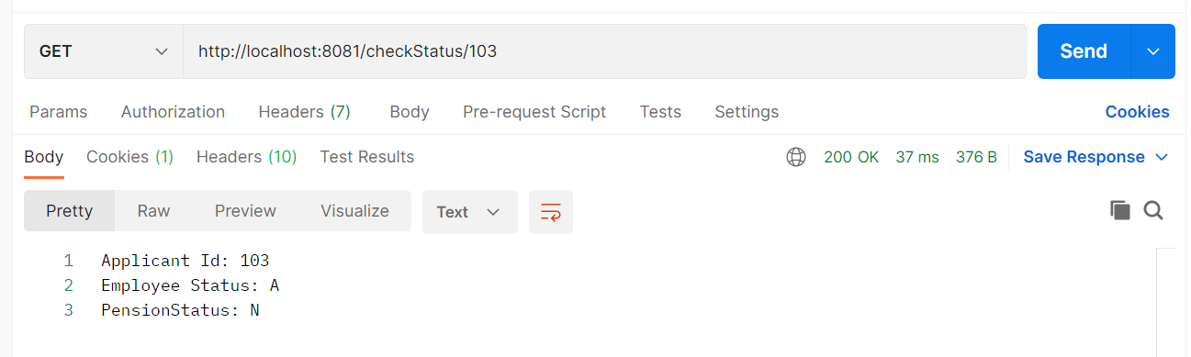
CheckStatus

Slide 17
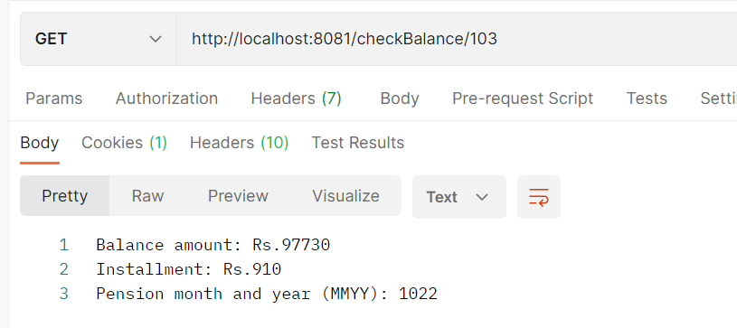
CheckBalance

Slide 18
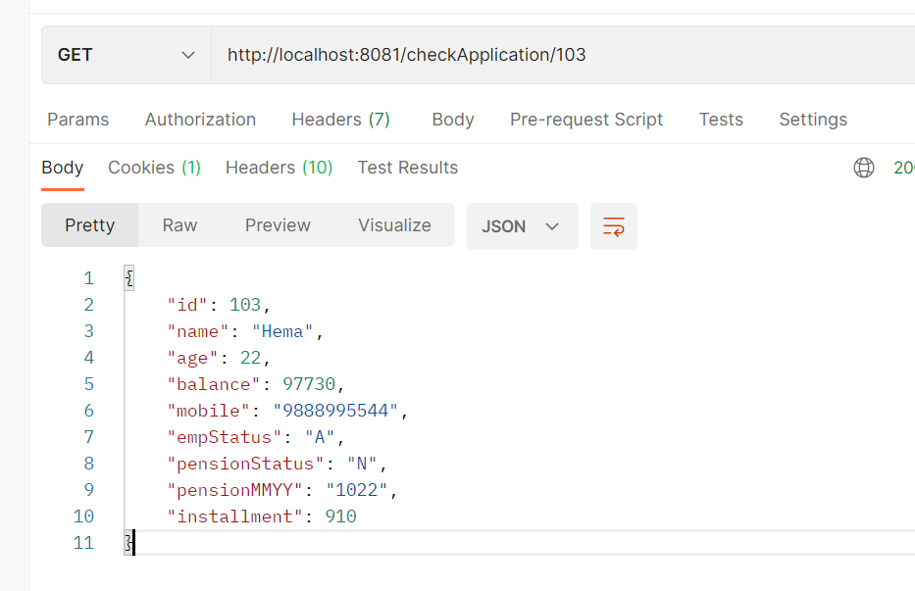
CheckApplication

Slide 19
Conclusion
REST is simple and widely supported.
Spring boot helps developers to focus on coding instead of configuration.
Microservices architecture improves performance, easier code reuse. Each service can be independently deployed.

Slide 20
Thank You

